Slide 1


Yuan Chung Ho
2nd March 2022

Slide 2

Outline
Executive Summary
Introduction
Methodology
Results
Conclusion
Appendix

Slide 3
Executive Summary
Summary of methodologies
Data Collection through API
Data Collection with Web Scraping
Data Wrangling
Exploratory Data Analysis with SQL
Exploratory Data Analysis with Data Visualization
Interactive Visual Analytics with Folium
Machine Learning Prediction
Summary of all results
Exploratory Data Analysis result
Interactive analytics in screenshots
Predictive Analytics result

Slide 4
Introduction
Project background and context
I predicted if the Falcon 9 first stage will land successfully. SpaceX advertises Falcon 9 rocket launches on its website, with a cost of 62 million dollars; other providers cost upward of 165 million dollars each, much of the savings is because SpaceX can reuse the first stage. Therefore, if we can determine if the first stage will land, we can determine the cost of a launch. This information can be used if an alternate company wants to bid against SpaceX for a rocket launch.
Problems you want to find answers
What factors does it impact the rocket land successfully ?
The interaction amongst various features that determine the success rate of a successful landing.
What operating conditions does SpaceX have to achieve to get the best results and make the best rocket success landing rate ?

Slide 5

Section 1

Slide 6
Methodology
Executive Summary
Data collection methodology:
Data was collected using SpaceX API and web scraping from Wikipedia.
Perform data wrangling
One-Hot Encoding was applied to categorical features on data field for ML models.
Perform exploratory data analysis (EDA) using visualization and SQL
Perform interactive visual analytics using Folium and Plotly Dash
Perform predictive analysis using classification models
How to build, tune, evaluate classification models.

Slide 7
Data Collection
The data was collected and cleaned using various methods.
Using get request to the SpaceX API.
Decoded the response content as a Json string using .json() function and turn it into a pandas data frame with .json_normalize().
Cleaned the data, checked for missing values and filled in missing value with .mean() function.
Performed web scraping from Wikipedia for Falcon 9 launch records with BeautifulSoup.
The objective was to extract the launch records as HTML table, parse the table and convert it to a pandas data frame for further analysis.

Slide 8
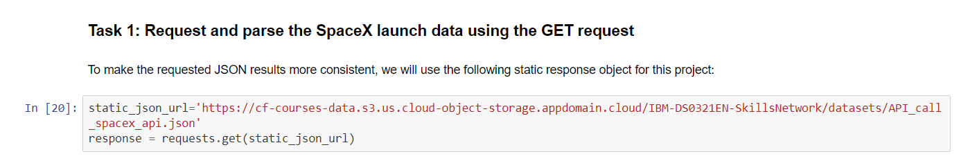
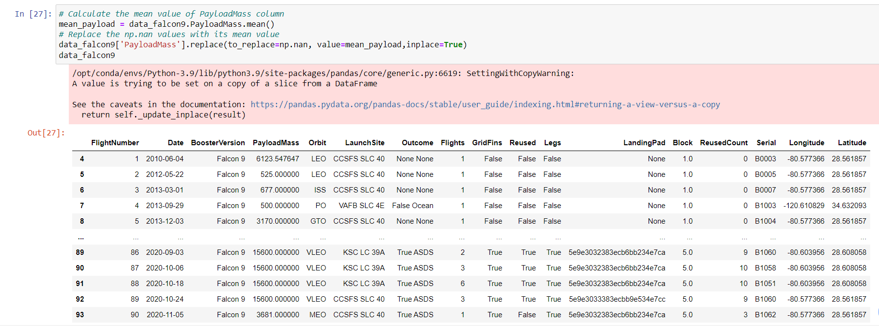
Data Collection – SpaceX API
1. Get request with launch data using SpaceX API.
Used the get request to the SpaceX API to collect data, clean the requested data and did some basic data wrangling and formatting.
Link to the Jupyter notebook. https://github.com/yuanchung1987/Data-Science-Final-Project/blob/master/Data%20Collection%20API.ipynb
2. Use json_normalize method to convert json result to dataframe.
2. Performed data cleaning and filing the missing values.

Slide 9
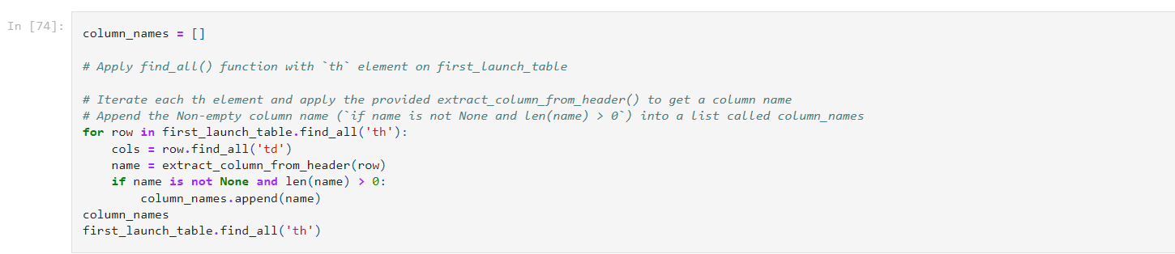
Data Collection - Scraping
1. Applied HTTP Get method to request the Falcon 9 wiki page.
Applied web scrapping to wikipedia Falcon 9 launch records with BeautifulSoup.
Parsed the table and converted it into a pandas dataframe.
Link as below. https://github.com/yuanchung1987/Data-Science-Final-Project/blob/master/Data%20Collection%20With%20Web%20Scraping%20Lab.ipynb
2. Create BeautifulSoup object from the HTML response.
3. Extract all column names from the HTML table header.
4. Create a dataframe by parsing the launch HTML tables.
5. Export the data to CSV file.

Slide 10
Data Wrangling
Objective to perform exploratory data analysis and determined the training labels.
Calculated the number of launches at each site, and the number and occurrence of each orbits
Created landing outcome label from outcome column and exported the results to csv.
The link to Jupyter notebook is https://github.com/yuanchung1987/Data-Science-Final-Project/blob/master/EDA-%20Data%20Wrangling.ipynb

Slide 11
EDA with Data Visualization
We explored the data by visualizing the relationship between flight number and launch Site, payload and launch site, success rate of each orbit type, flight number and orbit type, the launch success yearly trend with scatterplot and line chart to find the pattern of each data feature.
The link to Jupyter notebook is: https://github.com/yuanchung1987/Data-Science-Final-Project/blob/master/EDA-%20Visualization.ipynb

Slide 12
EDA with SQL
Loaded the SpaceX dataset into a IBM db2 database for data storage.
Applied EDA with SQL to get insight from the data. Wrote queries to find out for instance:
The names of unique launch sites in the space mission.
The total payload mass carried by boosters launched by NASA (CRS)
The average payload mass carried by booster version F9 v1.1
The total number of successful and failure mission outcomes
The failed landing outcomes in drone ship, their booster version and launch site names.
Link to Jupyter notebook: https://github.com/yuanchung1987/Data-Science-Final-Project/blob/master/EDA-%20SQL.ipynb

Slide 13
Build an Interactive Map with Folium
Marked all launch sites, and added map objects such as markers, circles, lines to mark the success or failure of launches for each site on the folium map.
Assigned the feature launch outcomes (failure or success) to class 0 and 1.i.e., 0 for failure, and 1 for success.
Using the color-labeled marker clusters, we identified which launch sites have relatively high success rate.
We calculated the distances between a launch site to its proximities. We answered some question for instance:
Are launch sites near railways, highways and coastlines.
Do launch sites keep certain distance away from cities.
Link to Jupyter notebook: https://github.com/yuanchung1987/Data-Science-Final-Project/blob/master/Interactive%20Visual%20Analytics%20with%20Folium.ipynb

Slide 14
Build a Dashboard with Plotly Dash
Built an interactive dashboard with Plotly dash
Plotted pie charts showing the total launches by a certain sites
Plotted scatter graph showing the relationship with Outcome and Payload Mass (Kg) for the different booster version.
The link to python code is: https://github.com/yuanchung1987/Data-Science-Final-Project/blob/master/app.py

Slide 15
Predictive Analysis (Classification)
Loaded the data using numpy and pandas, transformed the data, split our data into training and testing.
Built different machine learning models and tune different hyperparameters using GridSearchCV.
Used accuracy as the metric for our model, improved the model using feature engineering and algorithm tuning.
Found the best performing classification model.
Link to Jupyter notebook: https://github.com/yuanchung1987/Data-Science-Final-Project/blob/master/Machine%20Learning%20Prediction.ipynb

Slide 16
Results
Exploratory data analysis results
Interactive analytics demo in screenshots
Predictive analysis results

Slide 17

Section 2

Slide 18
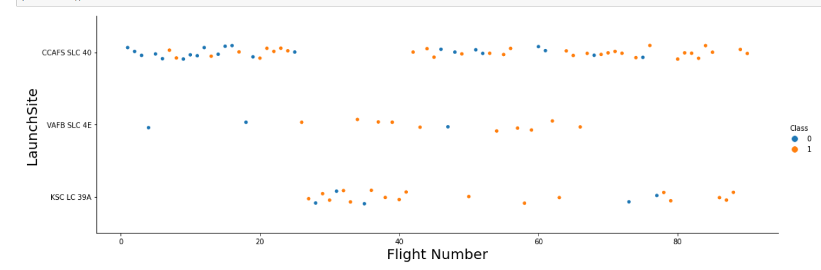
Flight Number vs. Launch Site
The more amount number of flight at launch site, the higher the success rate.

Slide 19
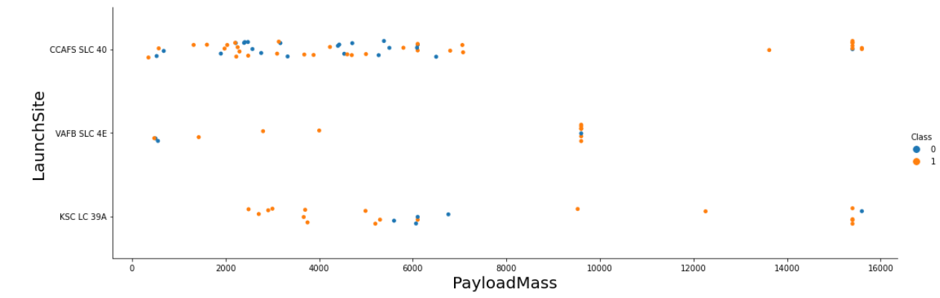
Payload vs. Launch Site
The higher payload mass the higher success rate for CCAFS SLC 40 site.

Slide 20
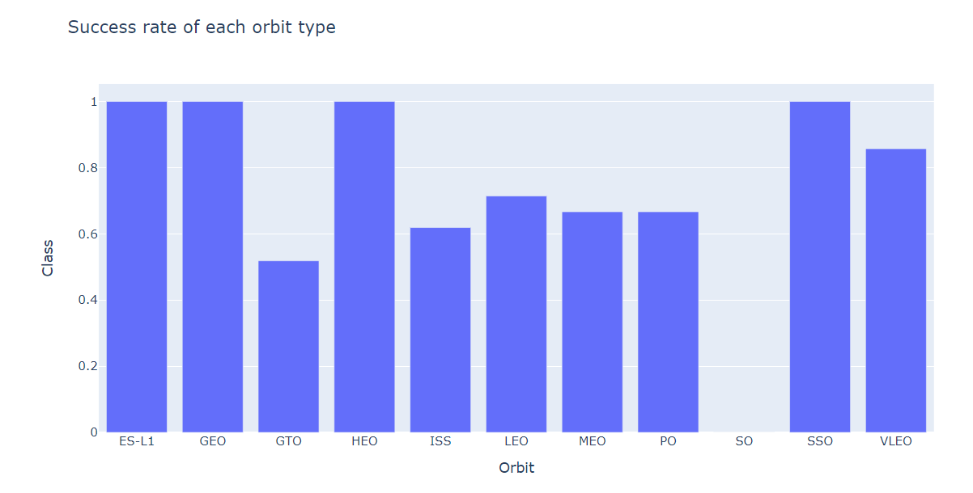
Success Rate vs. Orbit Type
From the plot, we can see that ES-L1, GEO, HEO, SSO, VLEO had the most success rate.

Slide 21
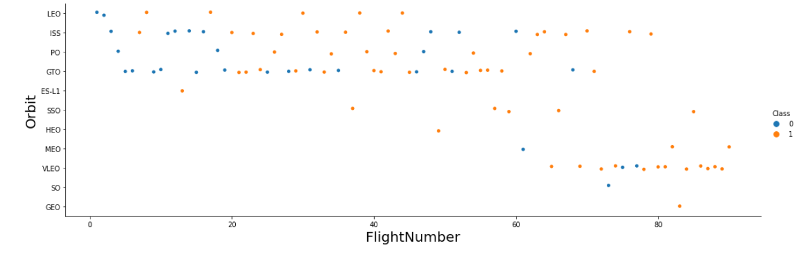
Flight Number vs. Orbit Type
Observed that in the LEO orbit, success rate is related to the number of flights whereas in the GTO orbit, there is no relationship between flight number and the orbit.

Slide 22
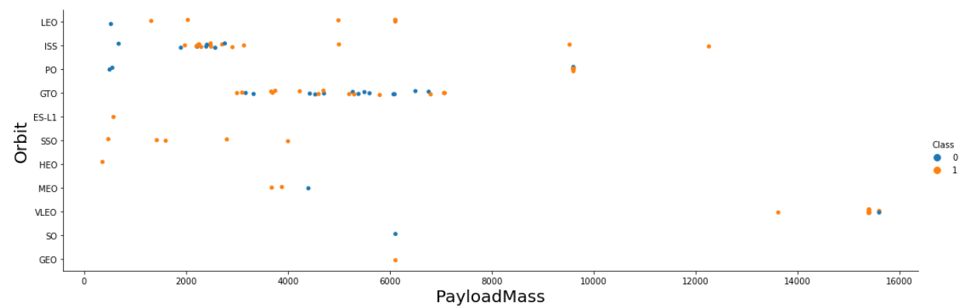
Payload vs. Orbit Type
There are heavy payloads, the successful landing are more for PO, LEO and ISS orbits.

Slide 23
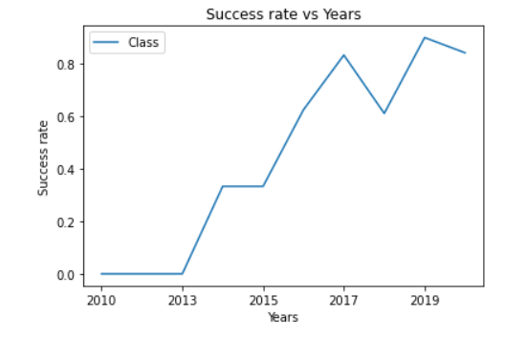
Launch Success Yearly Trend
We can observe that the success rate are increasing since 2013 till 2020.

Slide 24
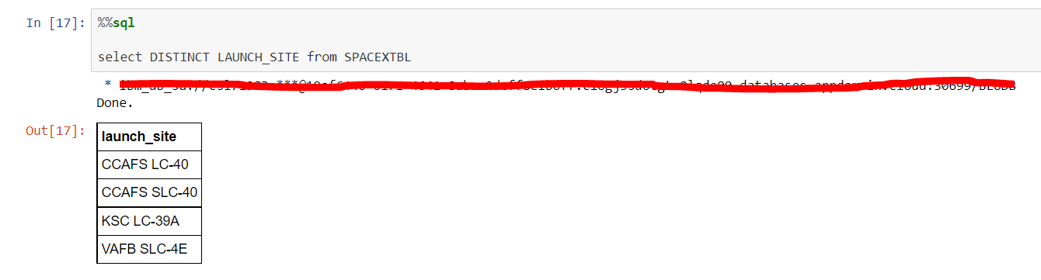
All Launch Site Names
Used the key word DISTINCT to show only unique launch sites from the SpaceX data.

Slide 25
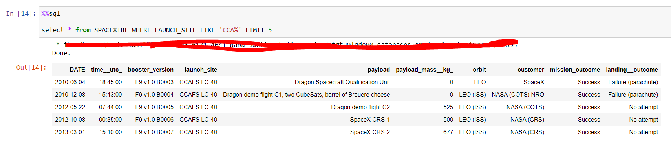
Launch Site Names Begin with 'CCA'
Used the query below to display 5 records where launch sites begin with `CCA`

Slide 26
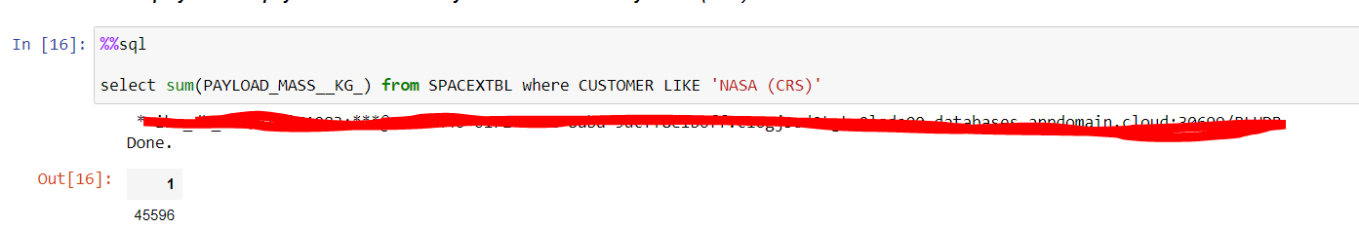
Total Payload Mass
Calculated the total payload carried by boosters from NASA as 45596 using the query below

Slide 27
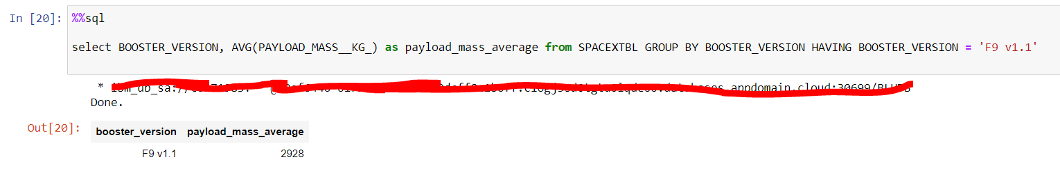
Average Payload Mass by F9 v1.1
Calculated the average payload mass carried by booster version F9 v1.1 as 2928.4

Slide 28
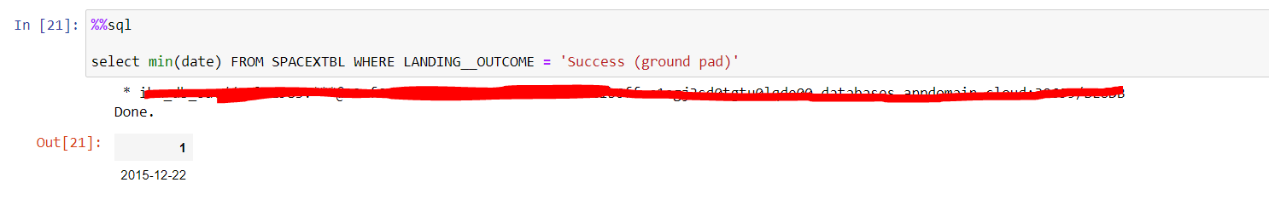
First Successful Ground Landing Date
Observed that the dates of the first successful landing outcome on ground pad was 22nd December 2015

Slide 29
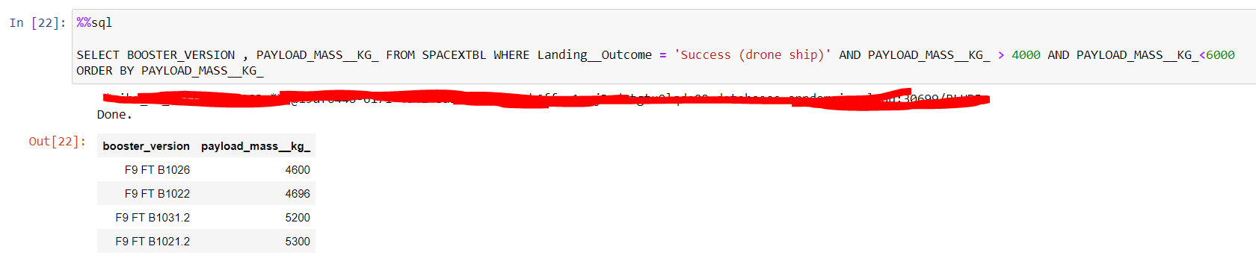
Successful Drone Ship Landing with Payload between 4000 and 6000
Used the WHERE clause to filter for boosters which have successfully landed on drone ship and applied the AND condition to determine successful landing with payload mass greater than 4000 but less than 6000

Slide 30
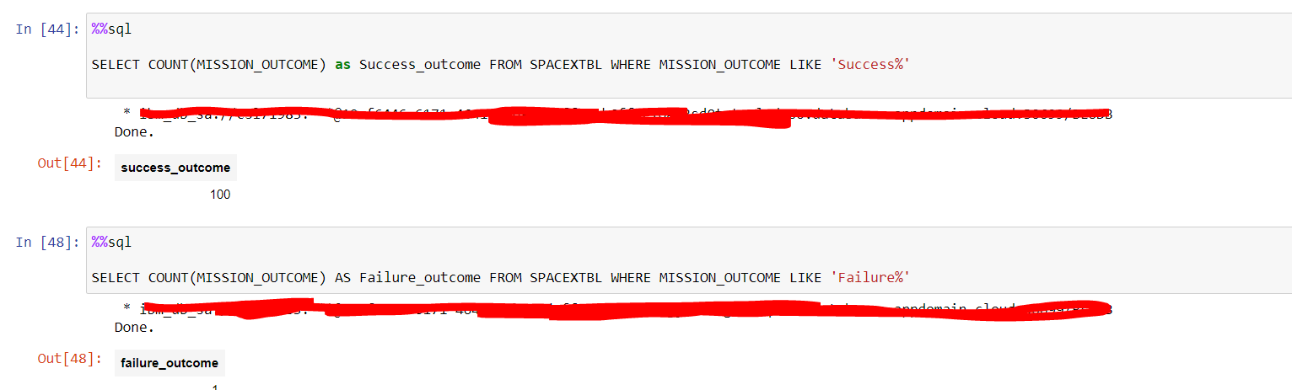
Total Number of Successful and Failure Mission Outcomes
Used code like ‘%’ to filter for WHERE Mission_Outcome was a success or a failure.

Slide 31
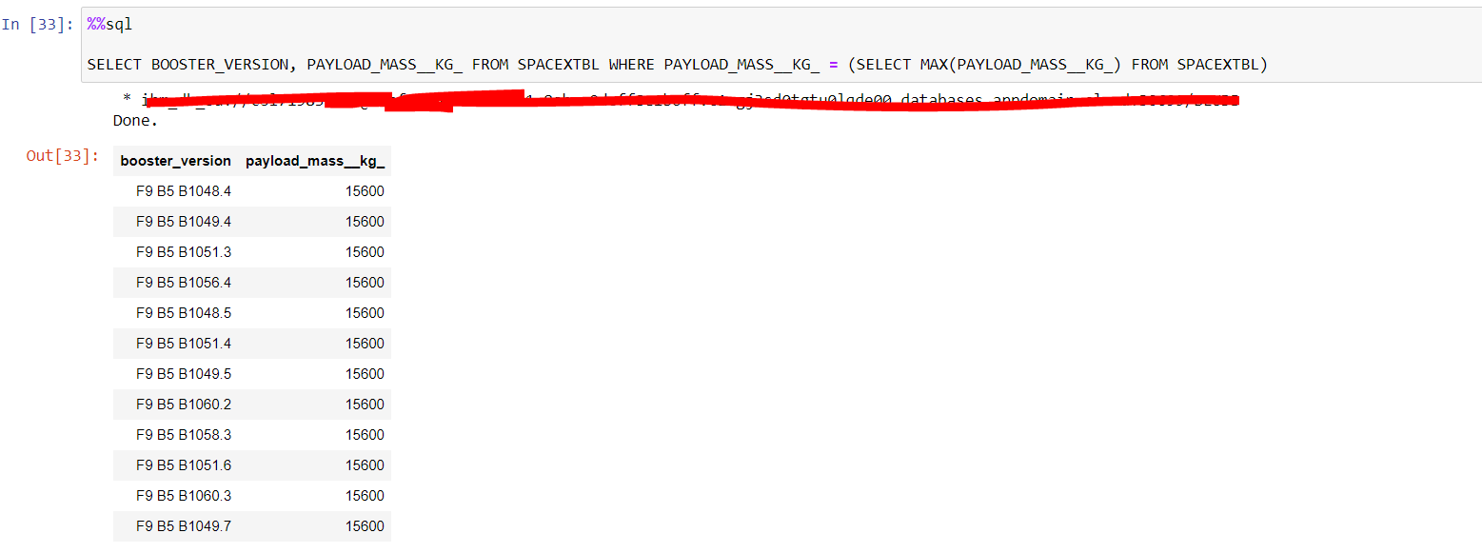
Boosters Carried Maximum Payload
Determined the booster that have carried the maximum payload using a subquery in the WHERE clause and the MAX() function.

Slide 32
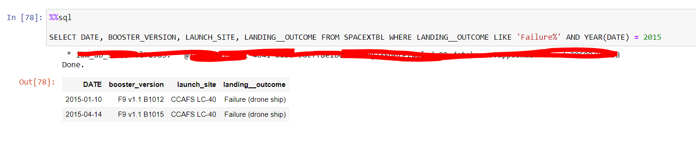
2015 Launch Records
We used a combinations of the WHERE clause, LIKE, AND, YEAR conditions to filter for failed landing outcomes in drone ship, their booster versions, and launch site names for year 2015

Slide 33
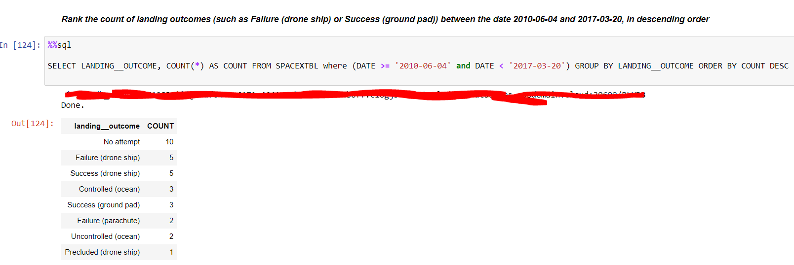
Rank Landing Outcomes Between 2010-06-04 and 2017-03-20
We selected Landing outcomes and the COUNT of landing outcomes from the data and used the WHERE clause to filter for landing outcomes BETWEEN 2010-06-04 to 2010-03-20.
We applied the GROUP BY clause to group the landing outcomes and the ORDER BY clause to order the grouped landing outcome in descending order.

Slide 34

Section 3

Slide 35
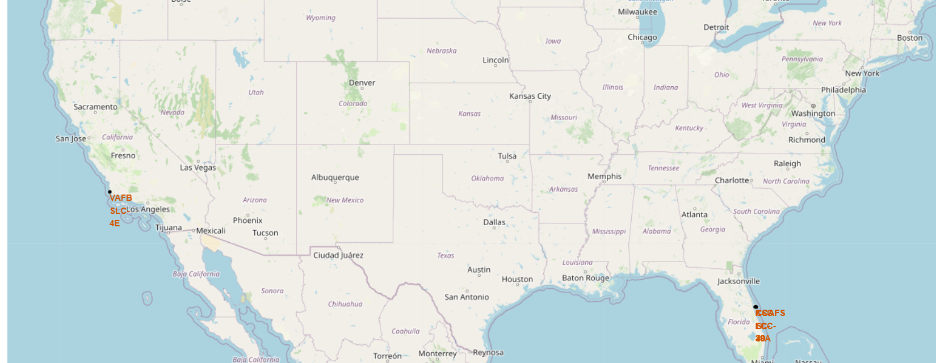
All launch sites global map markers
We can see the Falcon 9 launch sites are in United Stated coastline. Florida and California

Slide 36
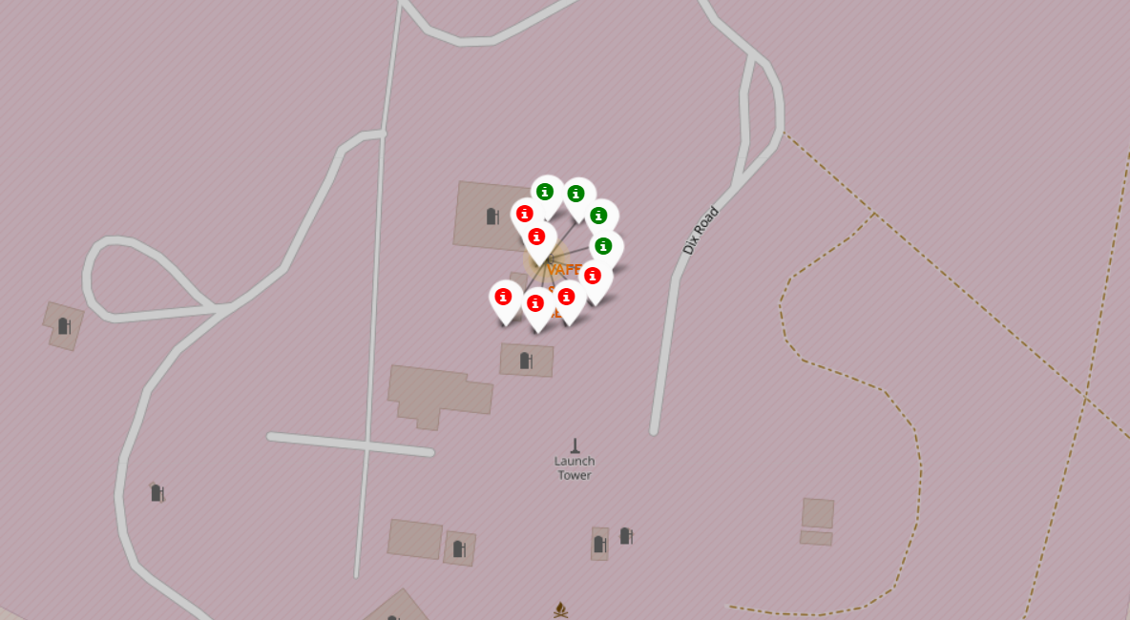
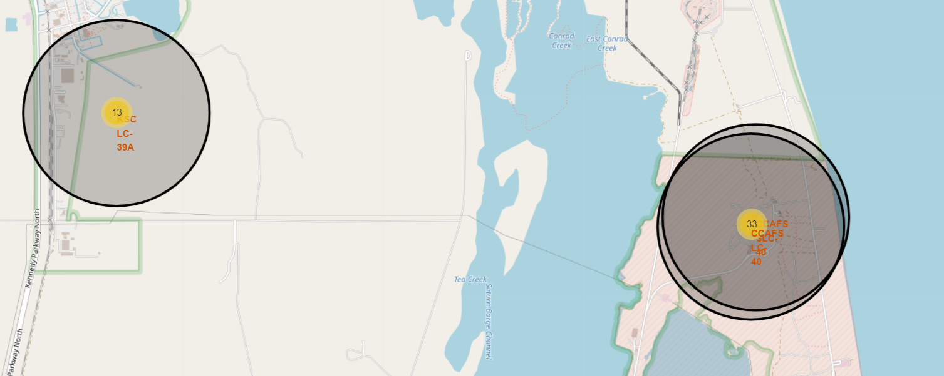
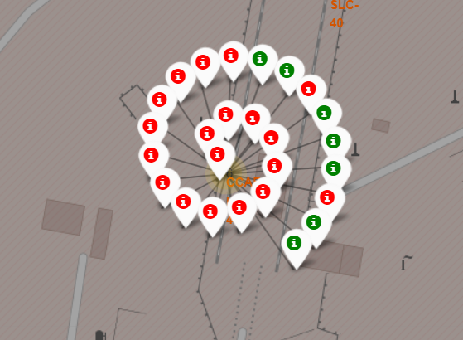
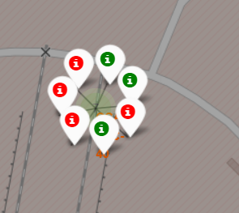
Markers showing launch sites with color labels
California site.
Florida site.
Green marker shows successful launch.
Red marker shows failure launch.

Slide 37
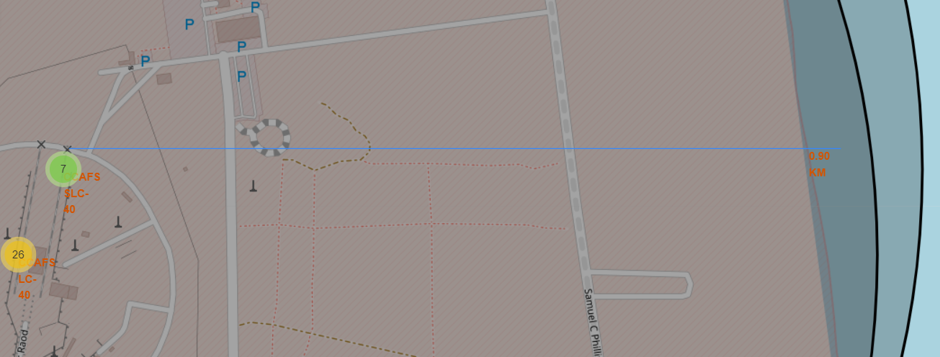
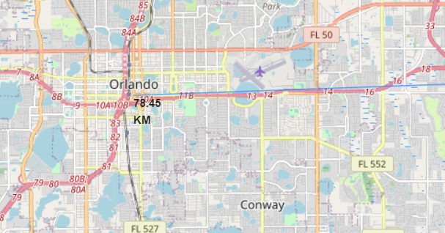
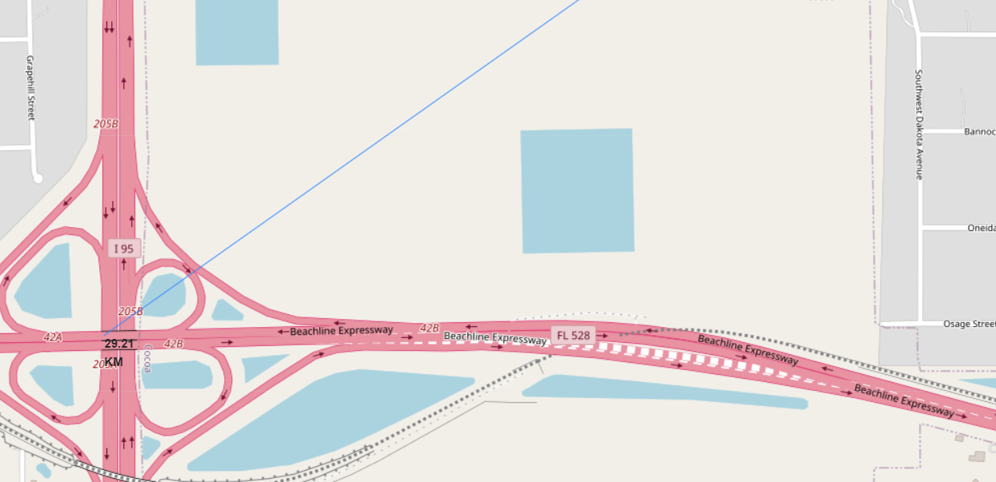
Launch Site distance to landmarks
Distance to coastline.
Distance to Orlando.
Distance to highway.

Slide 38

Section 4

Slide 39
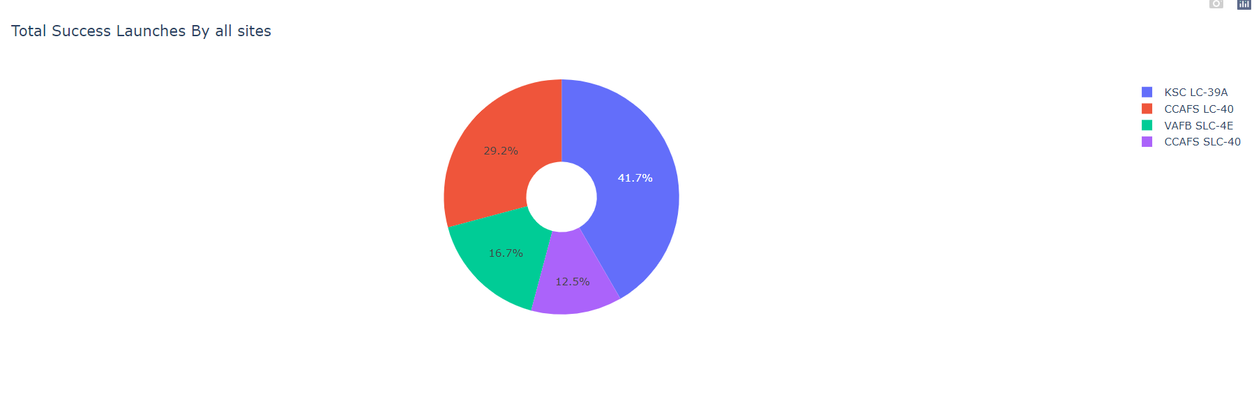
Pie chart showing the success percentage achieved by each launch site

Slide 40
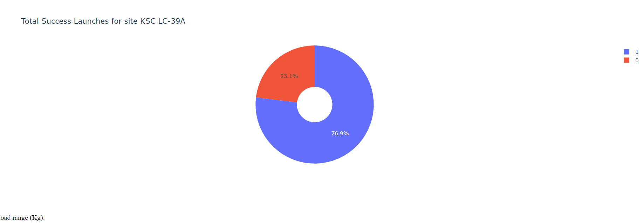
Pie chart showing the Launch site with the highest launch success ratio
The most success rate is on KSC LC-39A site.

Slide 41
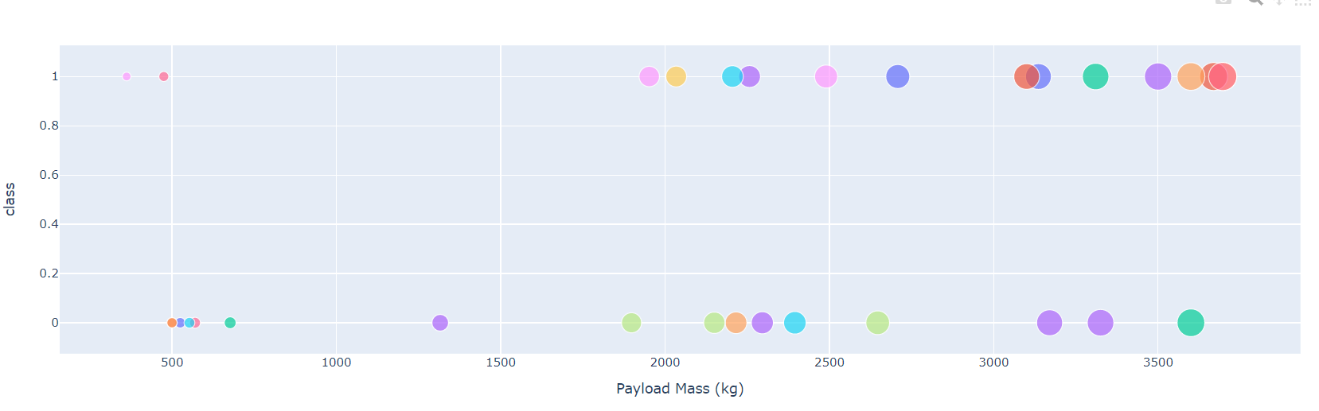
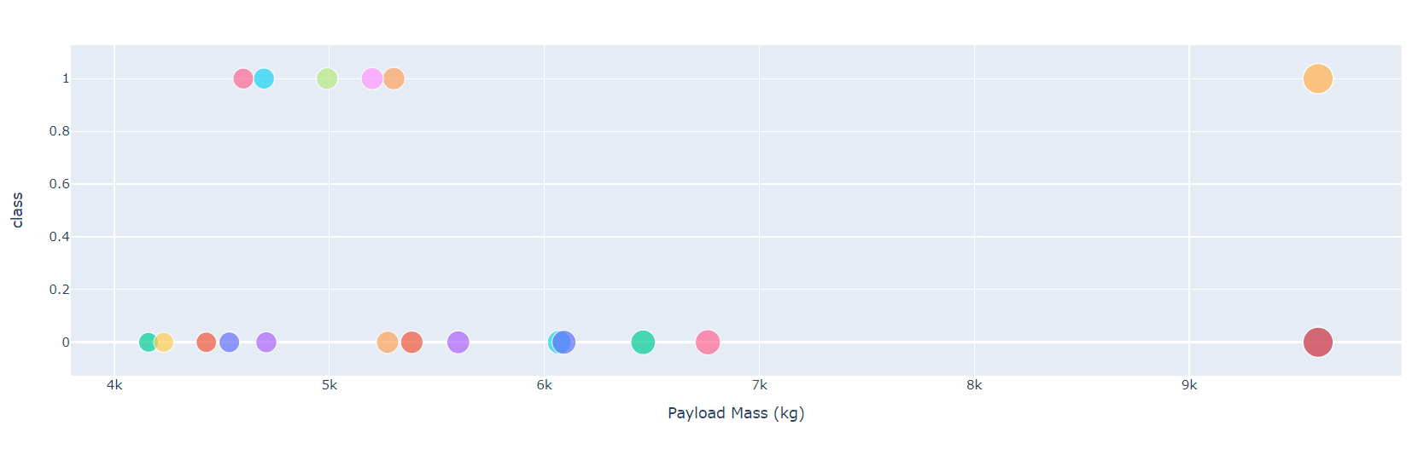
Scatter plot of Payload vs Launch Outcome for all sites, with different payload selected in the range slider
There seems to be lower weight has higher success rate.
0 kg – 4000 kg
4000 kg – 10000 kg

Slide 42

Section 5

Slide 43
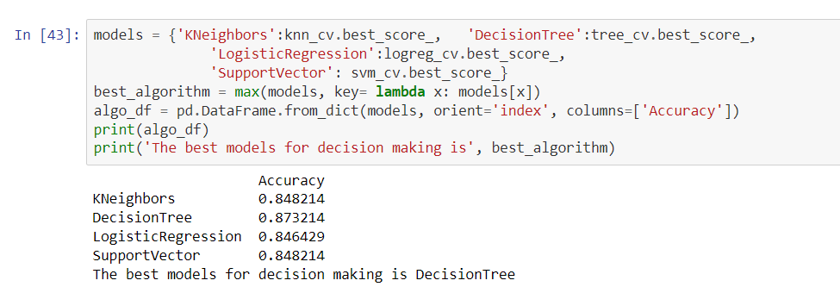
Classification Accuracy
The decision tree classifier is the model with the highest classification accuracy

Slide 44
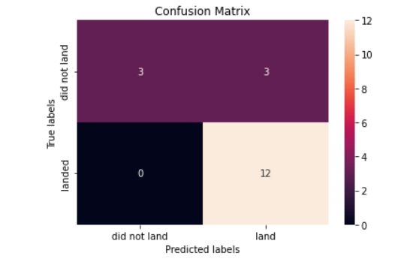
Confusion Matrix
The confusion matrix for the decision tree classifier shows that the classifier can distinguish between the different classes. The major problem is the false positive, i.e., the model predicts rocket land and it actually not landed.

Slide 45
Conclusions
From the analysis we can conclude that
The larger the flight amount at a launch site, the greater the success rate at a launch site.
Launch success rate started to increase in 2013 till 2020.
Orbits ES-L1, GEO, HEO, SSO, VLEO had the most success rate.
KSC LC-39A had the most successful launches of any sites.
The Decision tree classifier is the best machine learning algorithm for this task.

Slide 46


